Slide 1
Advanced – FILE I/O
Advanced File Input output operations
What is Atomicity
What is Race condition
Fcntl() - system call
What is Blocking and non-Blocking I/O calls
File descriptor Table and Open file Table
Inode of a file.

Slide 2
Multi Processing/Threading
Linux Provides a multi processing environment.
This means there are several process running parallelly in linux system.
Each Process based on its priority, The Scheduler gives every process a definite time on CPU to execute.
Hence giving the user a virtual feeling as if all process are executing at same time and in parallel.

Slide 3
Race condition
A race condition is a situation where the result produced by two processes (or threads) operating on shared resources depends in an unexpected way on the relative order in which the processes gain access to the CPU(s).

Slide 4
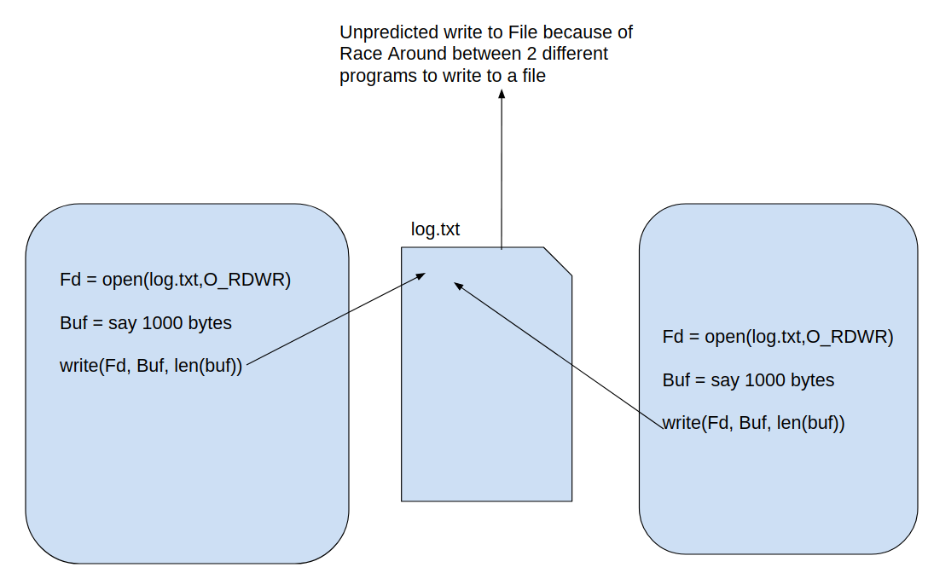
Race Round - Condition
Program 1
Program 2

Slide 5
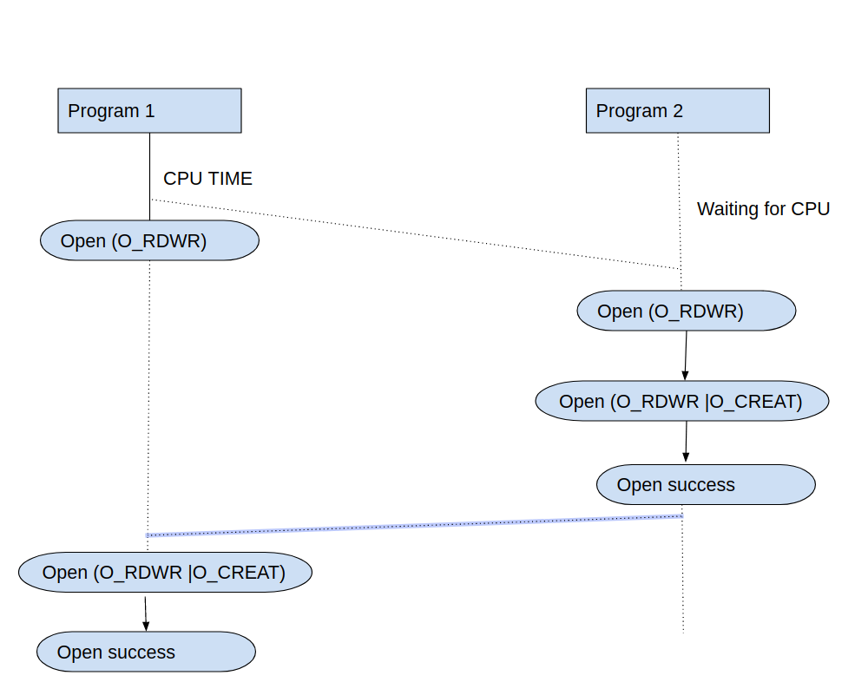
Race Round Condition
If open fails
If open fails

Slide 6
Atomicity
Atomicity is a condition in which the code is written in such a way that code cannot be run by other process/thread ‘AT SAME TIME’ while it is being executed/running by first process/thread.
All system calls in Linux are executed atomically. By this, we mean that the kernel guarantees that all of the steps in a system call are completed as a single operation. Also in Linux the system calls either return pass or fail, without any intermediate results.
The Atomicity is very much important to maintain in multi-processing environment like a linux system, else ‘Race Round’ condition can occur.

Slide 7
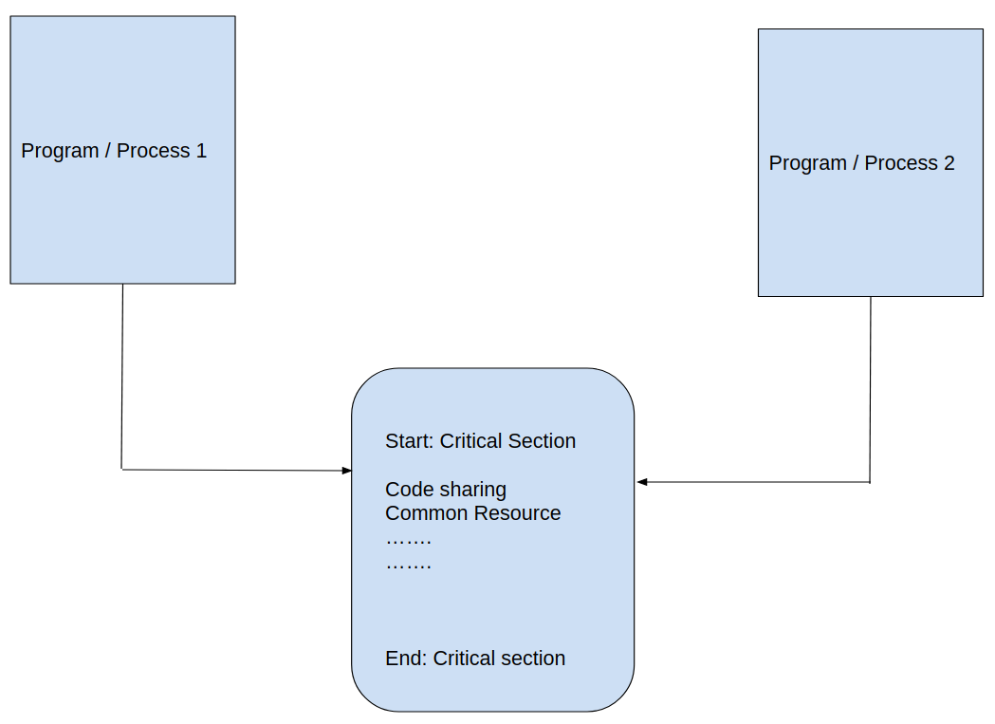
Atomicity

Slide 8
Pre-Emptive
Scheduling

Slide 9
Pre-Emptive Scheduler
Pre-emptive is a behaviour when the running process (say Process A) time slice is ended, the scheduler schedules new process (say Process B) the CPU time, and again this continues for different Process, and now the Process A will be scheduled back(given CPU time).
The Linux Kernel post 2.6 is a pre-emptive scheduling, can pre-empt the system calls running in kernel mode when it is in a safe to pre-empt state.
Before versions of linux kernel performed non preemptive system call scheduling. Which means when a process was running in kernel mode, it was not able for scheduler to schedule other process, until the running process voluntarily releases CPU, or returns back to user mode.

Slide 10
File descriptor table, File table and Inode table

Slide 11
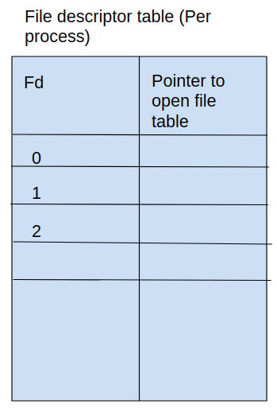
file descriptor table(per process)
File descriptor table(per process)
Each process will have its own file
descriptor table
This table holds all open file of
that process.

Slide 12
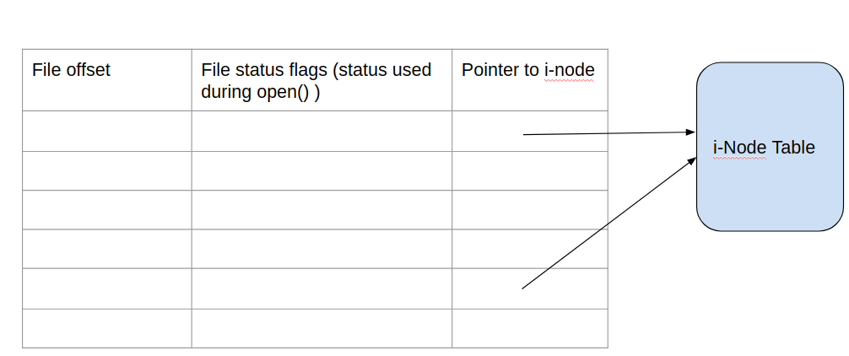
Open file table (System wide)

Slide 13
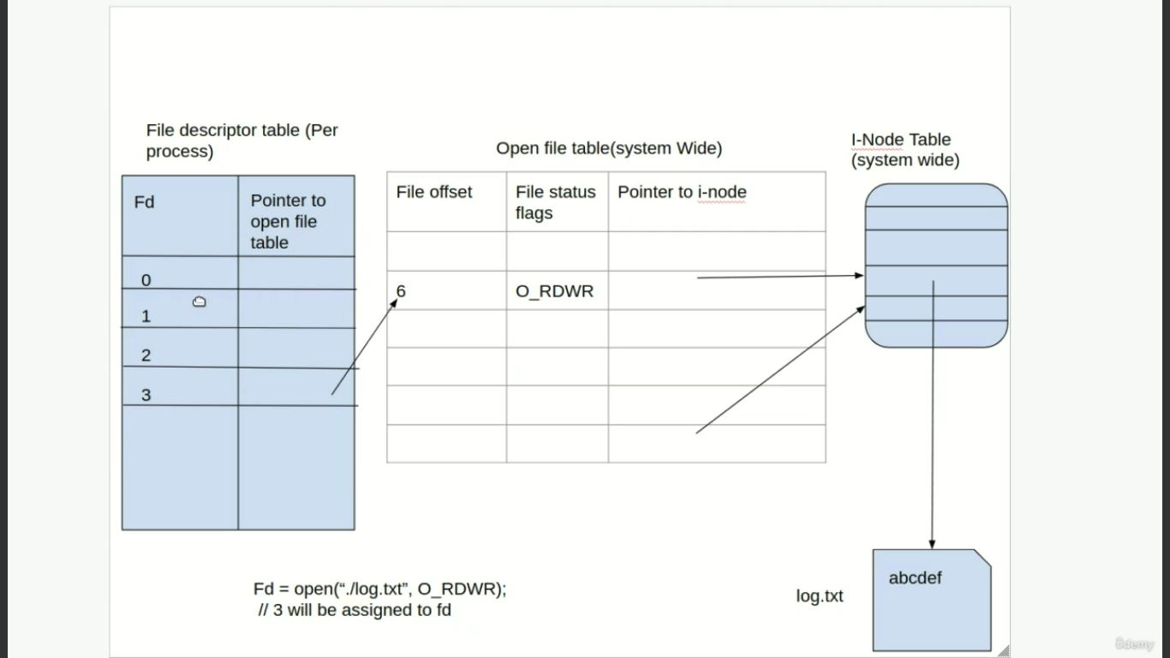

Slide 14
File offset – will contain pointer to data pointed in open file
File status – will contain all flags that was used to open the files.
I-node ptr – will contain pointer to the i-node which actually points to the files.

Slide 15
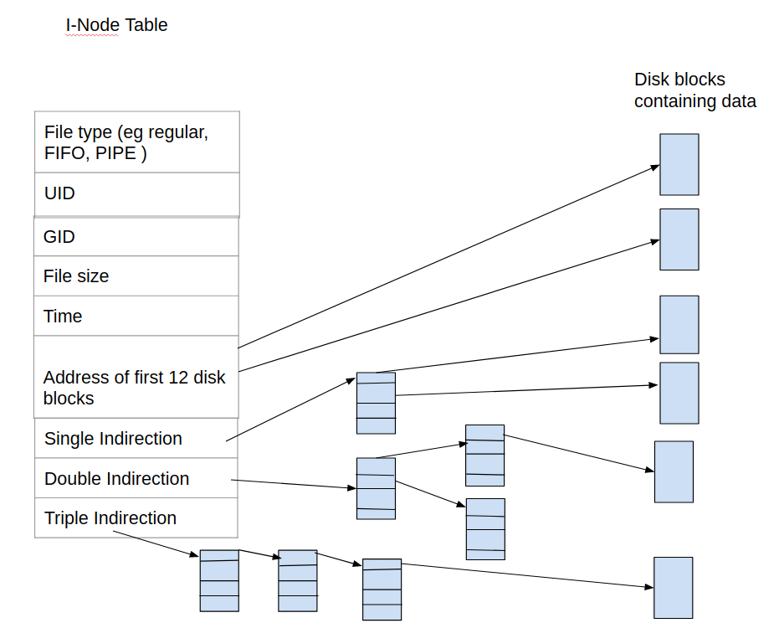
Inode - Table

Slide 16
Disk block size may be 4K Bytes, 8K Bytes, and so on
Generally Block size in Linux is 4KBytes
‘stat filename’ – will give status informaion of inode and file

Slide 17
File Type:
This keeps information about two things, one is the permission information, the other is the type of inode, for example an inode can be of a file, directory or a block device etc.
Owner Info: Access details like owner of the file(UID), group of the file (GID) etc.
Size: This location store the size of the file in terms of bytes.
Time Stamps: it stores the inode creation time, modification time, etc.
Block Size: Whenever a partition is formatted with a file system.It normally gets formatted with a default block size. Now block size is the size of chunks in which data will be spread.

Slide 18
I-node – data mapping
Address of first 12 block of memeory
Total memory it can map is (12X4k) = 48KB
Note : We are assuming block size is 4KiloByte.
Single Indirection
Total memory mapped = 4KB X 1KB = 4MB
because in single indirection the first block acts as a pointer to other blocks
since the pointer block has 4KB, and every pointer needs 4 bytes in memory, we have total 4K/4 = 1K(1024) pointers.

Slide 19
I-node – data mapping
Double Indirection
Total memory mapped = 4KB X 1KB X 1KB = 4GB
because in double redirection the first level and second level block acts as a pointer.
Triple Indirection
Total memory mapped = 4KB X 1KB X 1KB X 1KB = 4TB
because in triple indirection the first level , second level and third level block acts as a pointer.

Slide 21
Fcntl() - system call
The fcntl() system call performs a range of control operations on an open file descriptor
#include <fcntl.h>
int fcntl(int fd , int cmd , ...);
Return on success depends on cmd, or –1 on error

Slide 22
One use of fcntl() is to retrieve or modify the access mode and open file status flags of an open file.
int flags, accessMode;
flags = fcntl(fd, F_GETFL);
if (flags == -1)
{errExit("fcntl");}
accessMode = flags & O_ACCMODE;
if (accessMode == O_WRONLY || accessMode == O_RDWR)
printf("file is writable\n");
We can use the fcntl() F_SETFL command to modify some of the open file status flags.

Slide 23
Truncating Files
Linux provides two system calls for truncating the length of a file
#include <unistd.h>
#include <sys/types.h>
int ftruncate (int fd, off_t len);
and
int truncate (const char *path, off_t len);

Slide 24
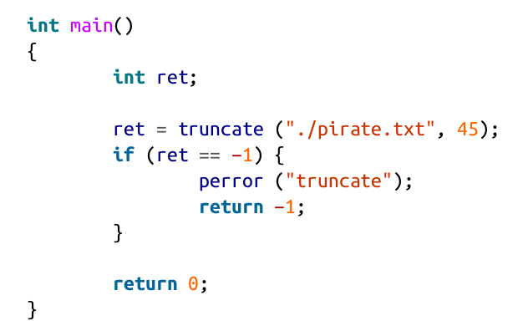

Slide 25
pirate.txt – before running program
Edward Teach was a notorious English pirate.
He was nicknamed Blackbeard.
pirate.txt – After running program
Edward Teach was a notorious English pirate.

Slide 26
Blocking and Non Blocking calls
Non Blocking system calls – These are system calls when user calls it, the function will check for the input, and return immediately to user space, even though the input is not available for that moment. These system calls produce error number if the return to system call had a error

Slide 27
Non blocking
if the given file descriptor was opened in nonblocking mode (if O_NONBLOCK was
given to open() and there is no data to read, the
read() call will return −1 and set errno to EAGAIN instead of blocking.

Slide 28
Blocking Calls
These system calls when called from user, will not return to user space, until the operation is performed. Eg: scanf() - Will wait until user presses a key from keyboard.

